Slide 1
Review of Lucy LEISA Data Archival Plan
Karl Hibbitts
9/23/2024

Slide 2
Overarching Comments
Goal: check delivery and SIS by attempting to derive calibrated data from one file of uncalibrated and compare to their derived calibrated data
The SIS document appeared thorough and clearly written when reviewing prior to data analysis. Attempting to calibrate raw data did highlight some weaknesses.
The inability to use PDS4 Viewer on a Mac proved an irritant, necessitating duplicate efforts in order to both view their calibrated data (on a PC) and derive calibrated data on the Mac. The viewer is incredibly useful for an initial look to get oriented; it really needs to be made to work on a Mac.
Calibrated means the individual frames are calibrated. There is no data that has been resampled spatially/spectrally to result in an image cube. Is geometric rectification not a requirement? Ie. this is not useful for science analysis, such as mapping composition etc, in its current format.

Slide 3
Details
When opening the image in PDS4viewer got a warning about an invalid display setting but otherwise looked fine;
Unclear on how to determine integration time.
from the file label:
int_time=73.89ms sp net integration time
int_time=69.84ms. leisa integration time
From the SIS: LEIINT = (XTNUM + 3 + (2048 - XTNUM) / 144 + DF) * 0.72ms – equation in SIS
leiint=(80+3 + ((2048-80)/144)+0)*.72ms which gives 69.6ms.
The array temperature is 119K, but calcorr for temperature only goes to 117K.

Slide 4
Details
The LEISA properties detailed in Table 2-1 was mostly a clear and effective description of along track output channels, individual pixels, and wavelengths. It also described the cross-track FOV and optimal science pixels in the crosstrack clearly. However, it left out where/when to apply the flatfield, although doing so is straightforward.
I referred pub mentioned in the data files: Levison, H.F., Marchi, S., Noll, K.S. et al. A contact binary satellite of the asteroid (152830) Dinkinesh. Nature 629, 1015–1020 (2024). However, there was no information presented in that paper from LEISA.
I used frame 620 (starts at 0) in file lei_0752129711_02300_sci_03.fit for analysis as both Dinkinesh and its satellite show up well. The calibrated data in lei_0752129956_02302_sci_04.fit seem to have some pedestal coming and going between frames.
I did NOT attempt to derive a spectrum
I was able to derive a reasonable radiance, but it did not match that of the calibrated image.
Following the steps in table 2.2.
temp=raw_621-deepspace;
temp=temp.*bpm.*flat03*int_time.*calcorr_t;

Slide 5
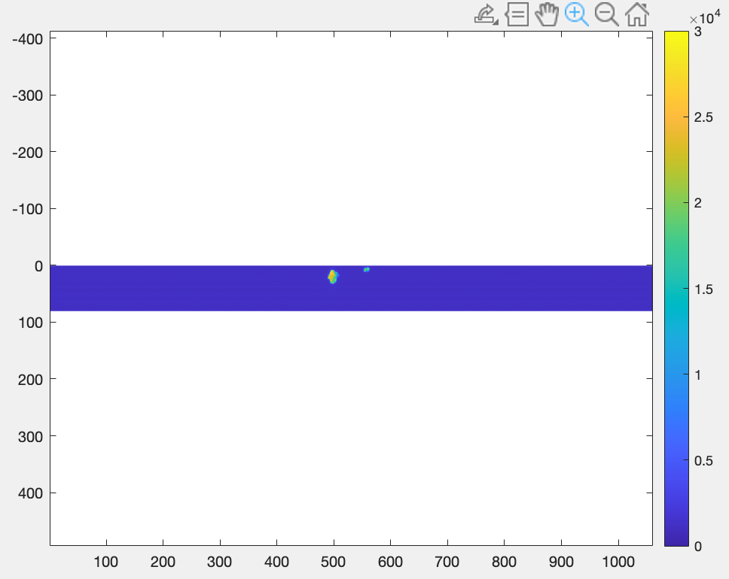
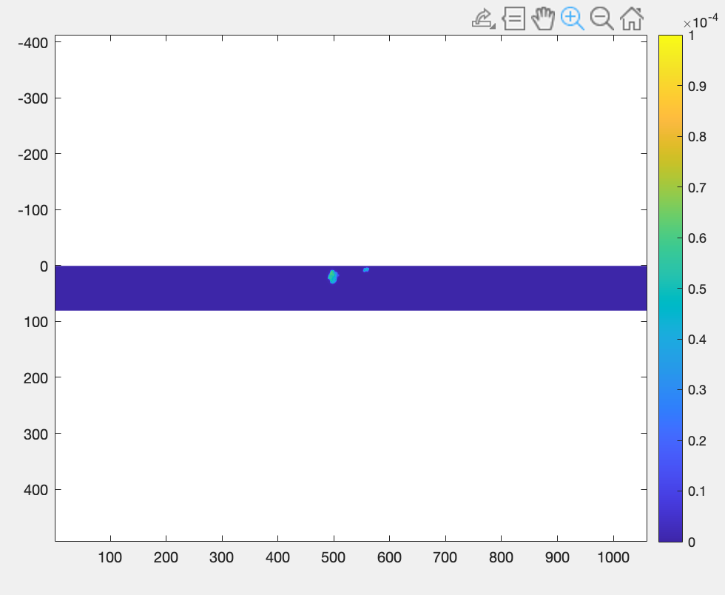
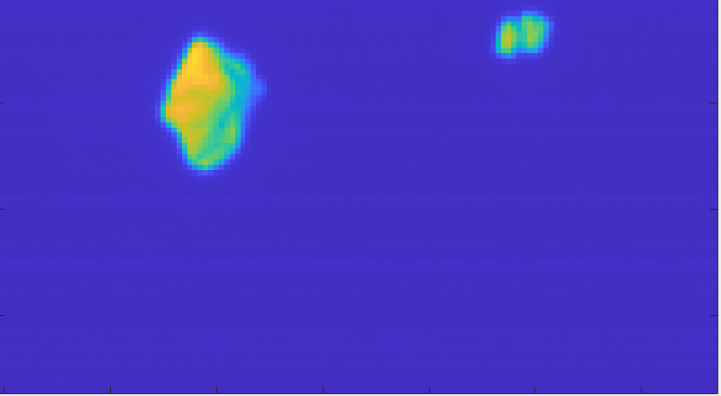
lei_0752129711_02300
PDS Raw image
PDS Calibrated image

Slide 6
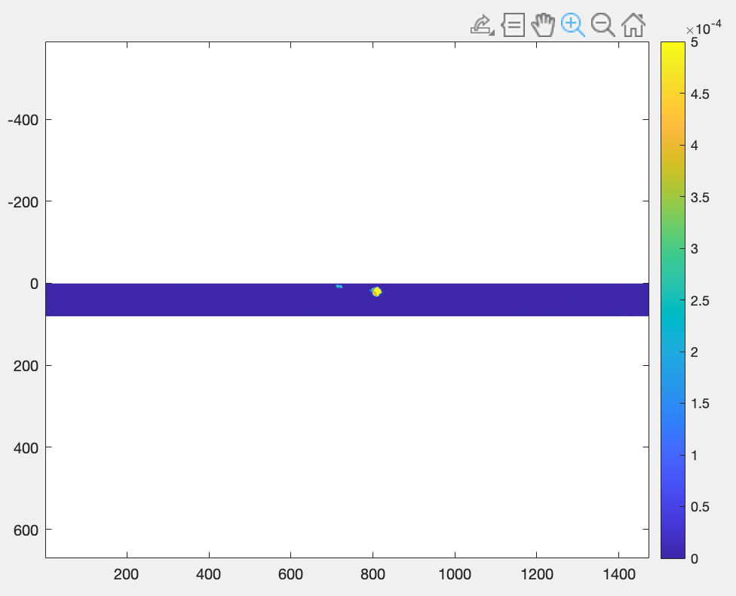
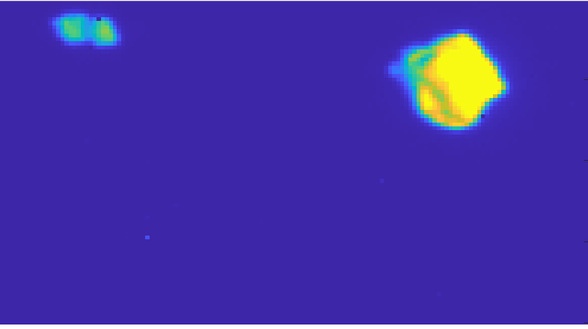
lei_0752129711_02300
My Calibrated image
PDS Calibrated image

